Slide 1
CHAPTER SUMMARY
5. SQL Query - Advance
Window Function Definition and Application
Window Function Related Keywords
Lab 7: Window Function Lab

Slide 2
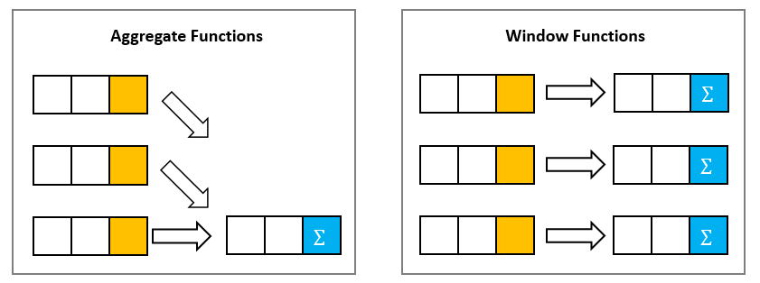
5.1 Window Function Definition and Application
Aggregation Function vs Window Function：
Aggregation：Condense a list of values into one number
Window： Condense a list of values into one number and put it back to each row

Slide 3
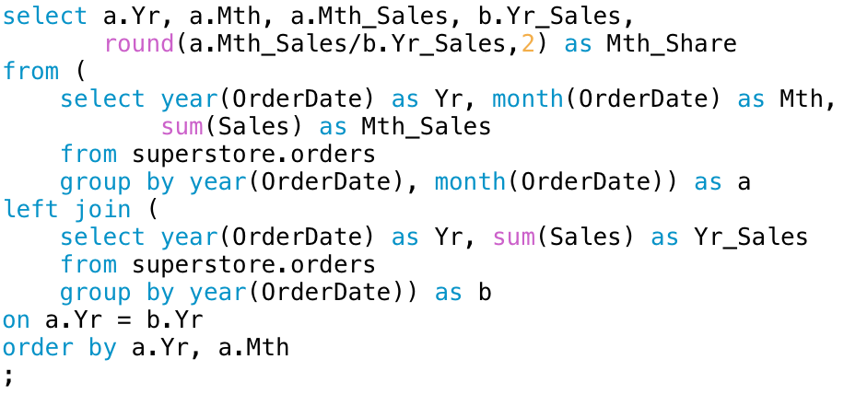
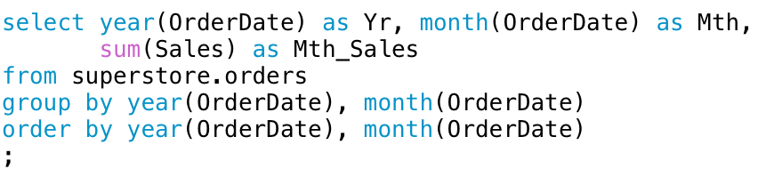
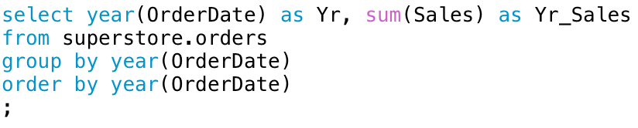
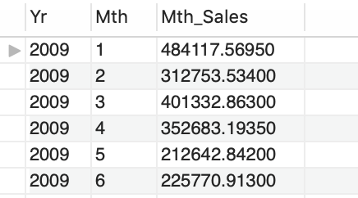
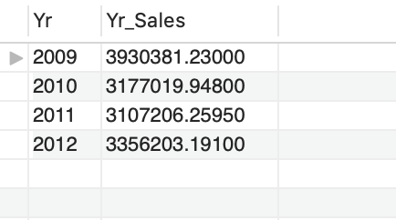
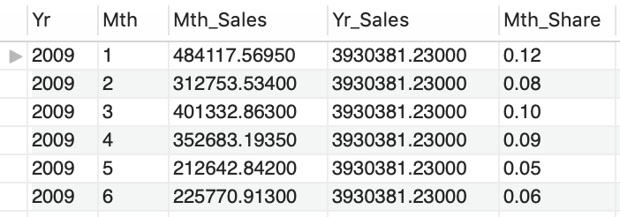
5.1 Window Function Definition and Application
Question：Calculate the proportion of monthly total revenue
Answer 1 : Without using window functions

Slide 4
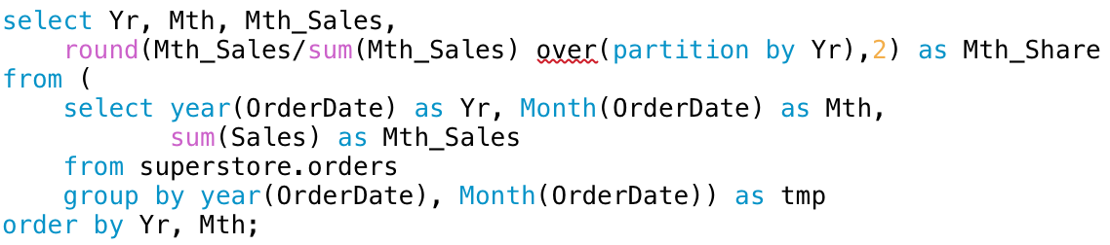
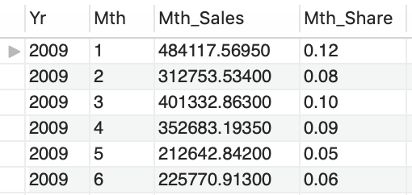
5.1 Window Function Definition and Application
Question：Calculate the proportion of monthly total revenue
Answer 2 : With window functions

Slide 5
5.1 Window Function Definition and Application
Window Function vs Aggregation Function + Table Join :
Shorter query, easy to understand
Better performance when avoiding table joining
Can meet the request of complex calculation logic
For each customer, calculate the % growth between the current month total
spend and the averaged total spend in the past three month

Slide 6
5.2 Window Function Related Keywords

Slide 7

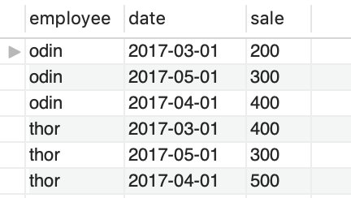

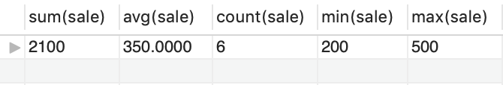
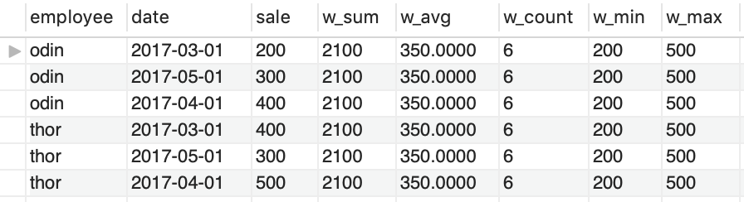
5.2 Window Function Related Keywords
OVER：
Do aggregation first
Then put the result back to row
Syntax：
OVER：
SELECT SUM(column_name) OVER()
FROM table_name;

Slide 8
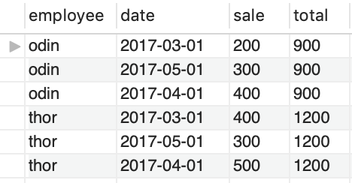
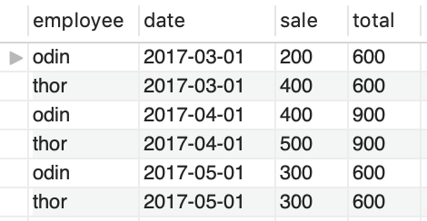
5.2 Window Function Related Keywords
PARTITION：
Break the table by partition
Then do OVER calculation
Syntax：
PARTITION：
SELECT SUM(column1)
OVER(PARTIRION BY column2)
FROM table_name;

Slide 9
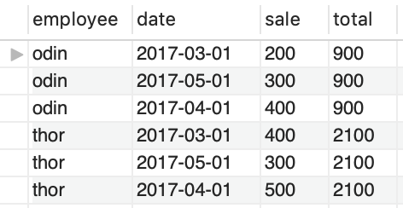
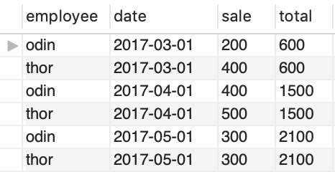
5.2 5.2 Window Function Related Keywords
ORDER：
Sort the table by specific column
Do OVER Calculation
Cumulate the result from last row
Syntax：
ORDER：
SELECT SUM(column1)
OVER(ORDER BY column2)
FROM table_name;

Slide 10
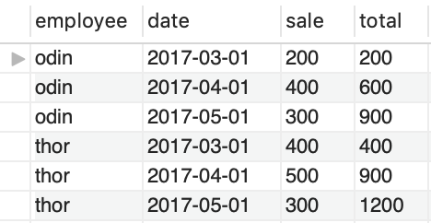
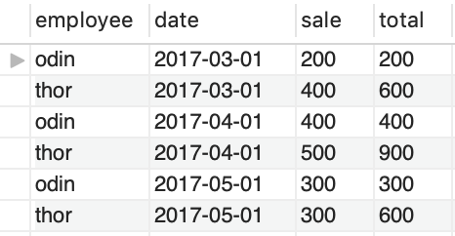
5.2 5.2 Window Function Related Keywords
PARTITON+ORDER：
Do PARITIRION Calculation
Do ORDER Calculation
Syntax：
PARTITION + ORDER：
SELECT SUM(column1)
OVER(PARTIRION BY column2
ORDER BY column3)
FROM table_name;

Slide 11
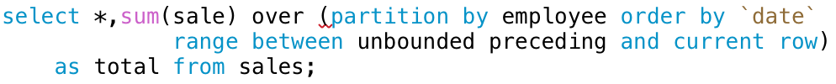
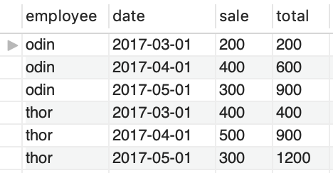
5.2 Window Function Related Keywords
PRECEDING/FOLLOWING：
Unbounded – Current Row
In each PARTITION, include the first row to the current row
Syntax：
PRECEDING/FOLLOWING：
SELECT SUM(column1)
OVER(PARTIRION BY column2
ORDER BY column3
RANGE BETWEEN … AND …)
FROM table_name;

Slide 12
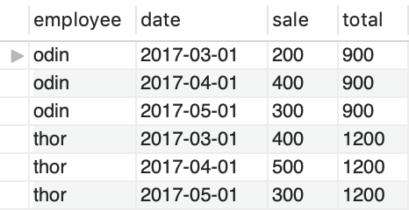
5.2 Window Function Related Keywords
PRECEDING/FOLLOWING：
Unbounded – Unbounded
In each PARTITION, include the first row to the last row
Syntax：
PRECEDING/FOLLOWING：
SELECT SUM(column1)
OVER(PARTIRION BY column2
ORDER BY column3
RANGE BETWEEN … AND …)
FROM table_name;

Slide 13
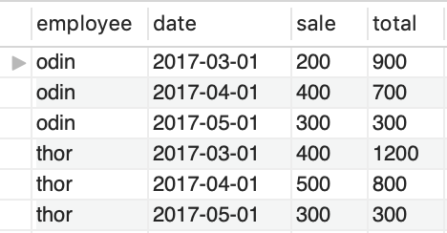
5.2 Window Function Related Keywords
PRECEDING/FOLLOWING：
Current – Unbounded
In each PARTITION, include the current row to the last row
Syntax：
PRECEDING/FOLLOWING：
SELECT SUM(column1)
OVER(PARTIRION BY column2
ORDER BY column3
RANGE BETWEEN … AND …)
FROM table_name;

Slide 14
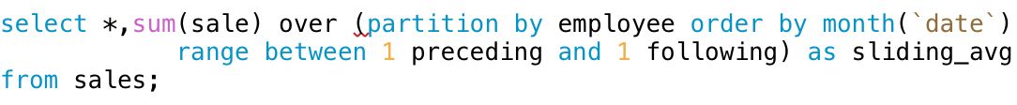
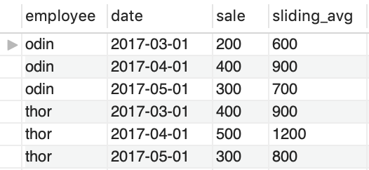
5.2 Window Function Related Keywords
PRECEDING/FOLLOWING运算：
N – N
In each PARTITION, include the Nth row before to the Nth row after referring to the current row
Syntax：
PRECEDING/FOLLOWING：
SELECT SUM(column1)
OVER(PARTIRION BY column2
ORDER BY column3
RANGE BETWEEN … AND …)
FROM table_name;

Slide 15

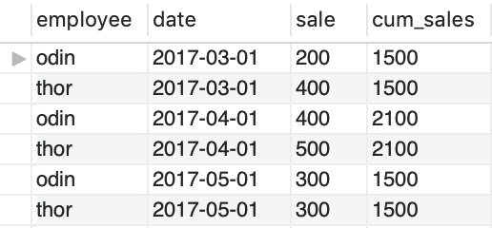
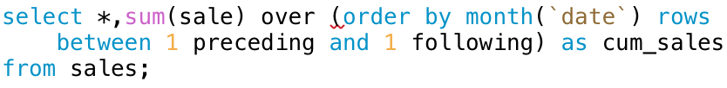
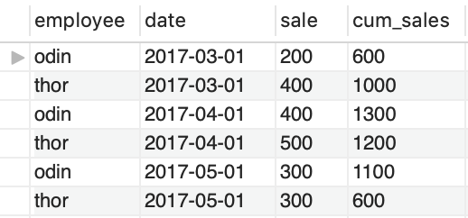
5.2 Window Function Related Keywords
Range/Row：
Range – Combine the duplicate results as one value
Row – Treat duplicates as individual
Syntax：
RANGE/ROWS：
SELECT SUM(column1)
OVER(PARTIRION BY column2
ORDER BY column3
RANGE/ROWS BETWEEN … AND …)
FROM table_name;

